Slide 1
4.14 (Optional) GUI and Graphics Case Study: Creating Simple Drawings
Java’s coordinate system is a scheme for identifying points on the screen.
The upper-left corner of a GUI component has the coordinates (0, 0).
A coordinate pair is composed of an x-coordinate (the horizontal coordinate) and a y-coordinate (the vertical coordinate).
The x-coordinate is the horizontal location (from left to right).
The y-coordinate is the vertical location (from top to bottom).
The x-axis describes every horizontal coordinate, and the y-axis every vertical coordinate.
Coordinate units are measured in pixels. The term pixel stands for “picture element.” A pixel is a display monitor’s smallest unit of resolution.

Slide 2
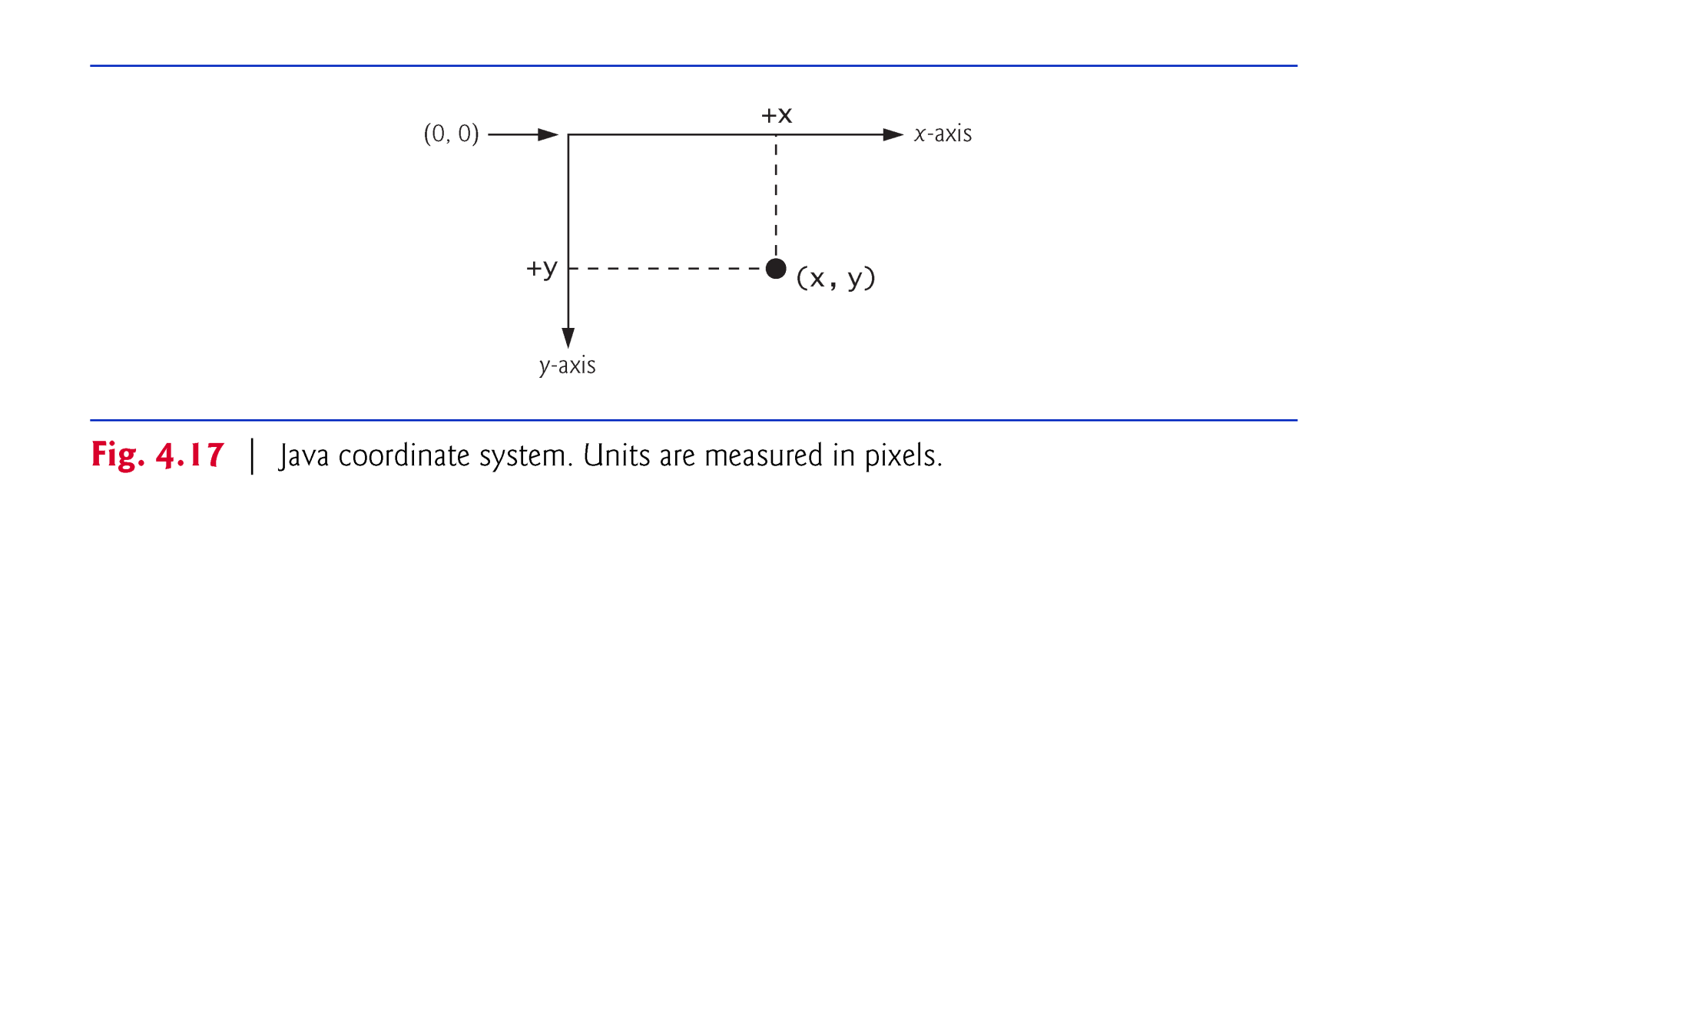

Slide 3
4.14 (Optional) GUI and Graphics Case Study: Creating Simple Drawings (Cont.)
Class Graphics (from package java.awt) provides various methods for drawing text and shapes onto the screen.
Class JPanel (from package javax.swing) provides an area on which we can draw.

Slide 4
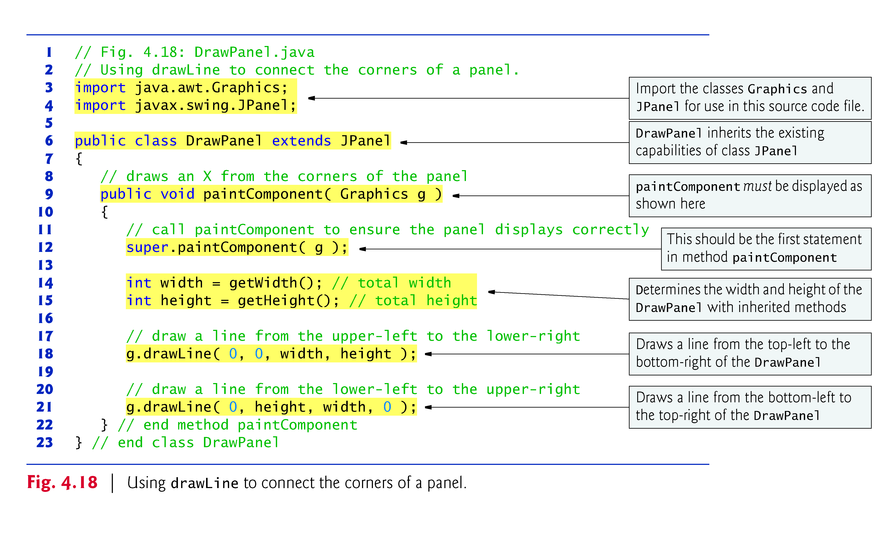

Slide 5
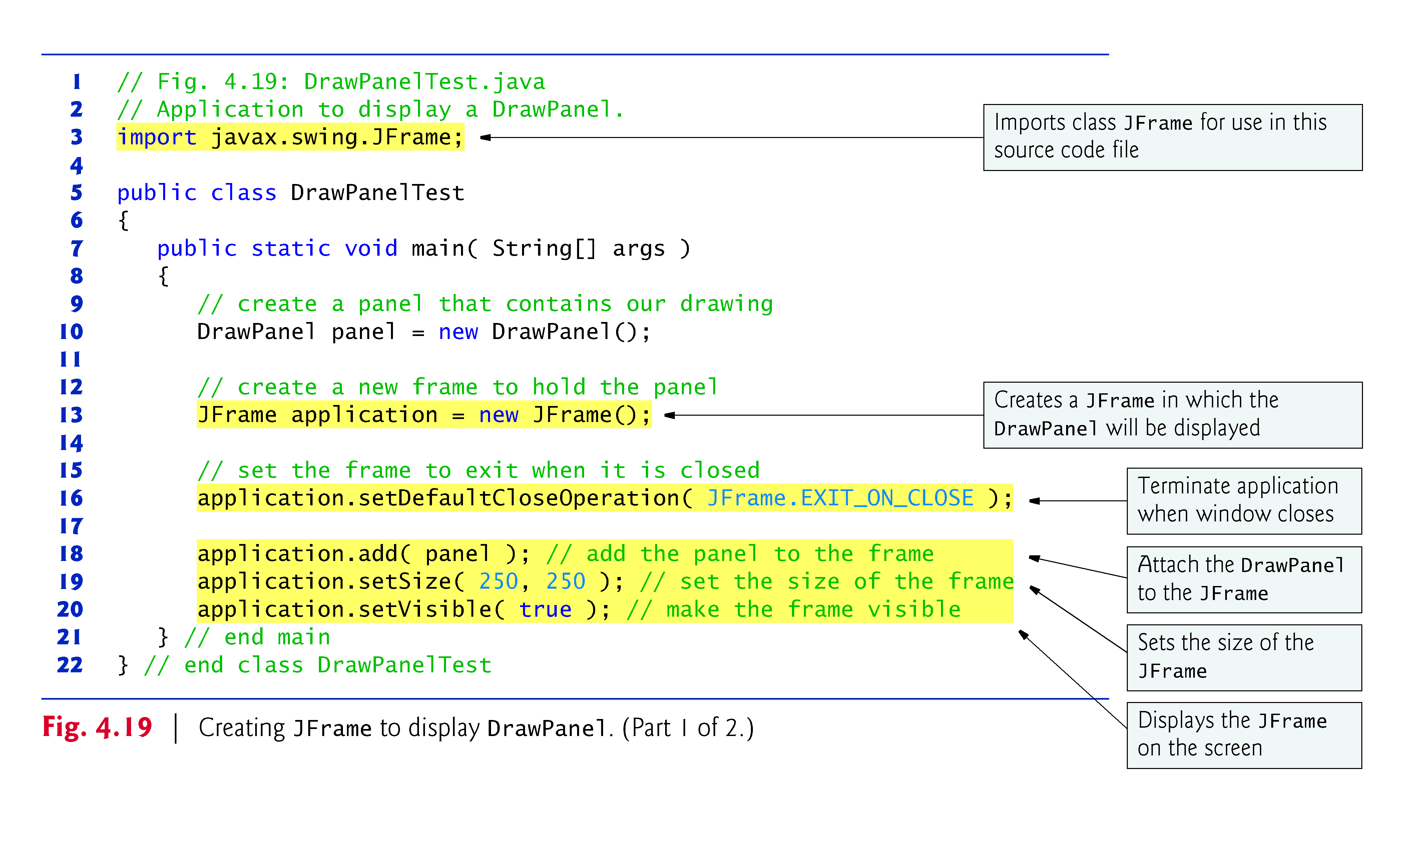

Slide 6
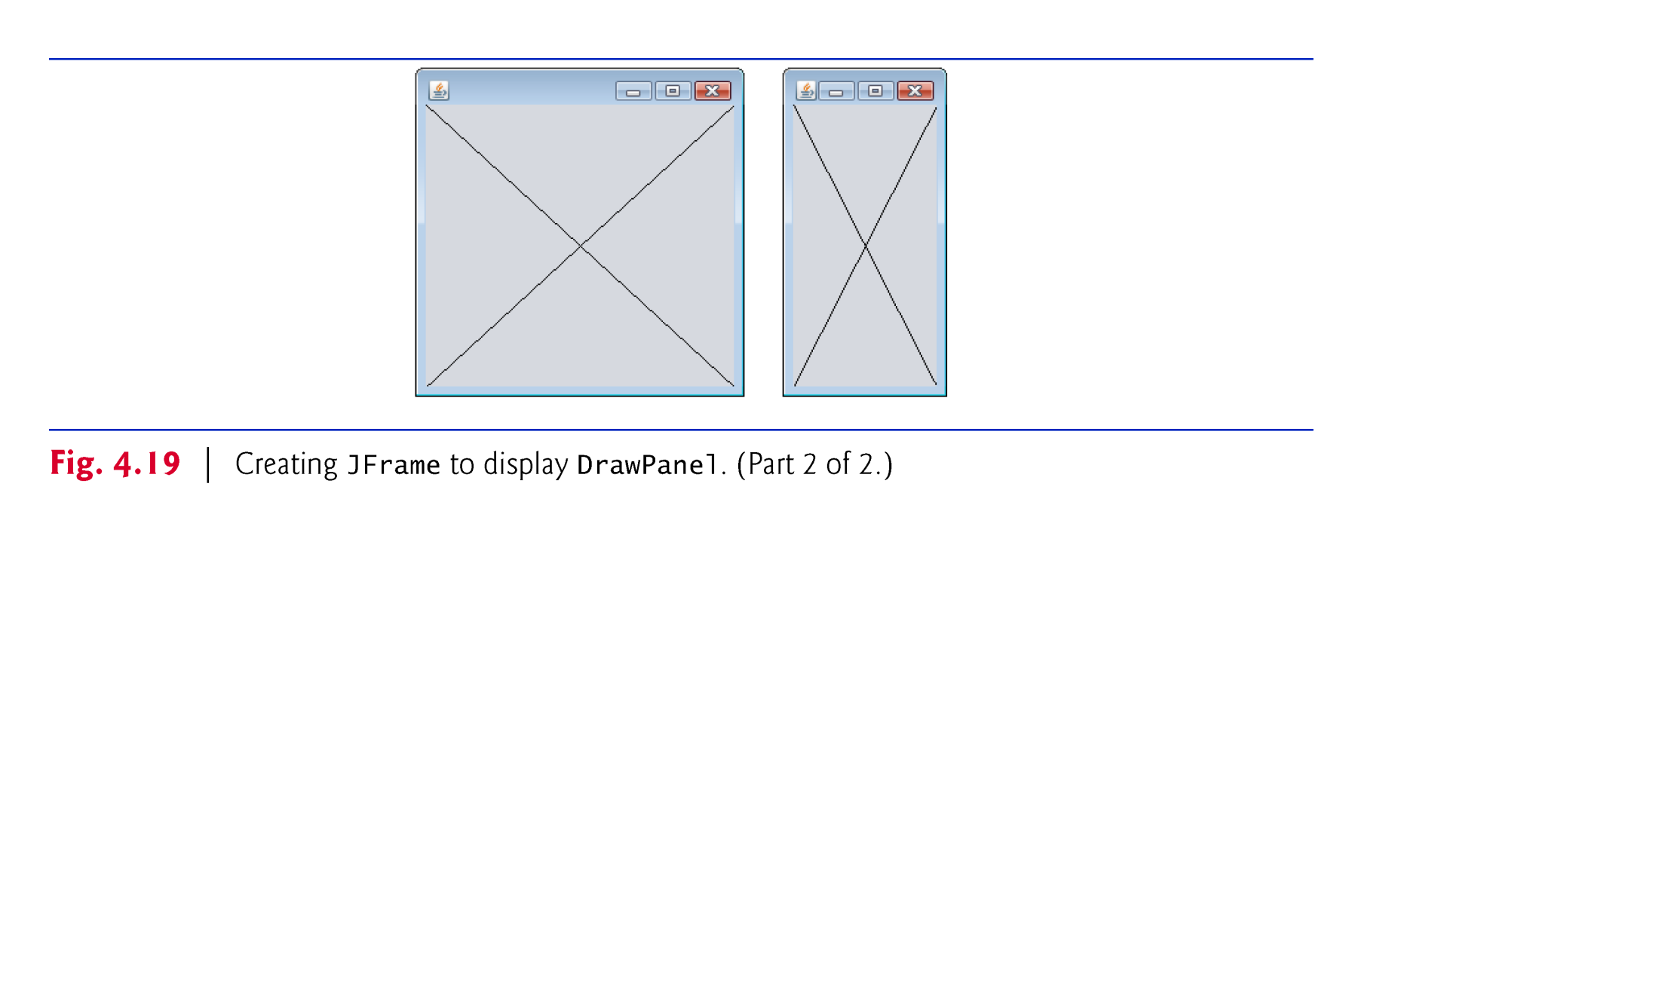

Slide 7
4.14 (Optional) GUI and Graphics Case Study: Creating Simple Drawings (Cont.)
The keyword extends creates a so-called inheritance relationship.
The class from which DrawPanel inherits, JPanel, appears to the right of keyword extends.
In this inheritance relationship, JPanel is called the superclass and DrawPanel is called the subclass.

Slide 8
4.14 (Optional) GUI and Graphics Case Study: Creating Simple Drawings (Cont.)
JPanel has a paintComponent method, which the system calls every time it needs to display the JPanel.
The first statement in every paintComponent method you create should always be
super.paintComponent( g );
JPanel methods getWidth and getHeight return the JPanel’s width and height, respectively.
Graphics method drawLine draws a line between two points represented by its four arguments. The first two are the x- and y-coordinates for one endpoint, and the last two arguments are the coordinates for the other endpoint.

Slide 9
4.14 (Optional) GUI and Graphics Case Study: Creating Simple Drawings (Cont.)
To display the DrawPanel on the screen, place it in a window.
Create a window with an object of class JFrame.
JFrame method setDefaultCloseOperation with the argument JFrame.EXIT_ON_CLOSE indicates that the application should terminate when the user closes the window.
JFrame’s add method attaches the DrawPanel (or any other GUI component) to a JFrame.
JFrame method setSize takes two parameters that represent the width and height of the JFrame, respectively.
JFrame method setVisible with the argument true displays the JFrame.
When a JFrame is displayed, the DrawPanel’s paintComponent method is implicitly called

Slide 10
5.10 (Optional) GUI and Graphics Case Study: Drawing Rectangles and Ovals
Graphics methods drawRect and drawOval
Method drawRect requires four arguments. The first two represent the x- and y-coordinates of the upper-left corner of the rectangle; the next two represent the rectangle’s width and height.
To draw an oval, method drawOval creates an imaginary rectangle called a bounding rectangle and places inside it an oval that touches the midpoints of all four sides.
Method drawOval requires the same four arguments as method drawRect. The arguments specify the position and size of the bounding rectangle for the oval.

Slide 11
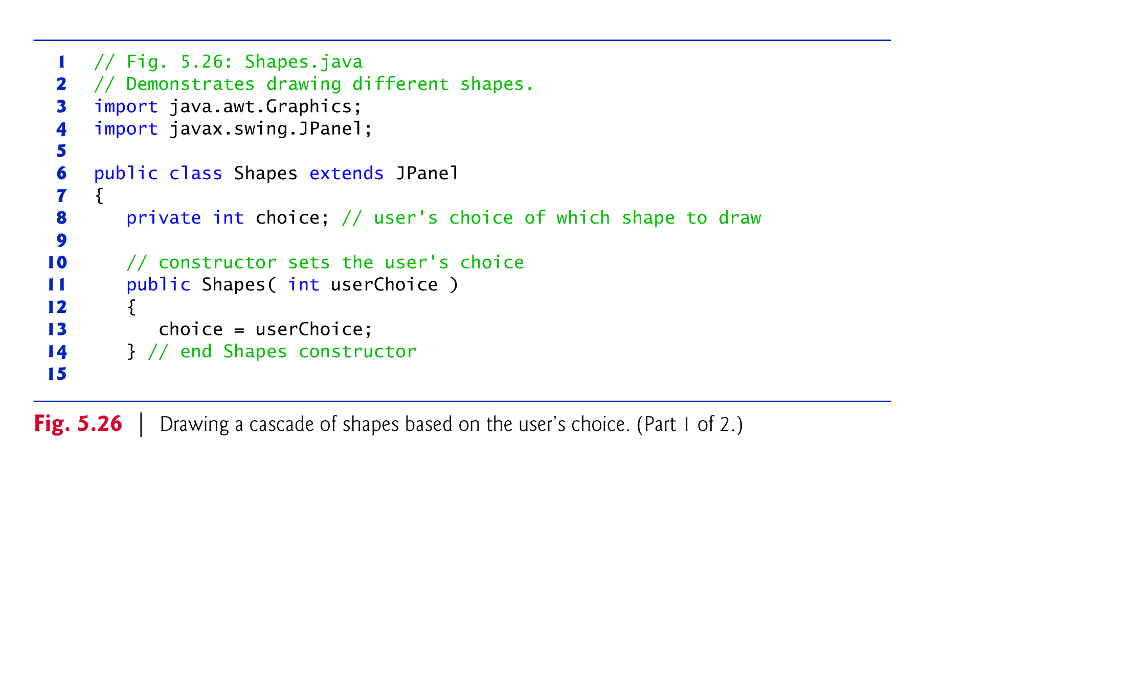

Slide 12
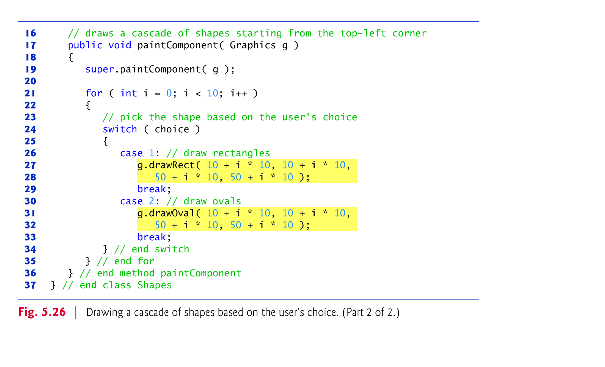

Slide 13
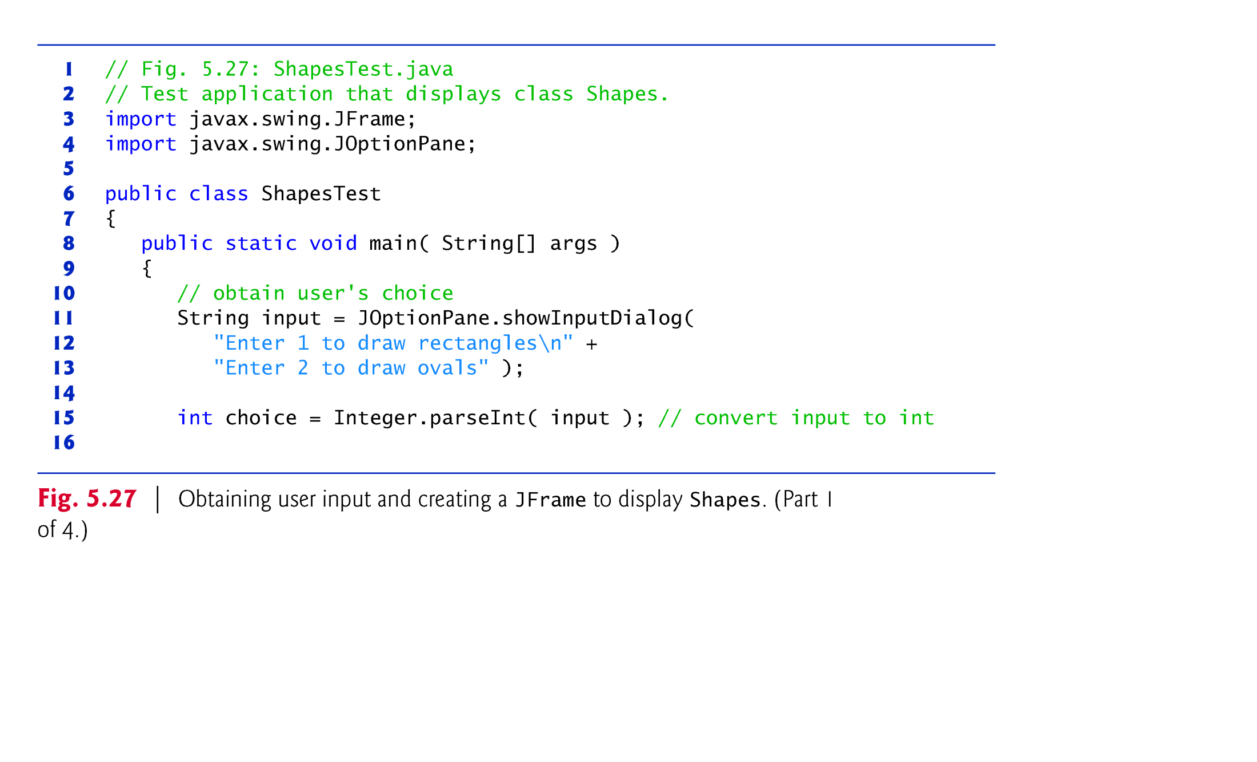

Slide 14
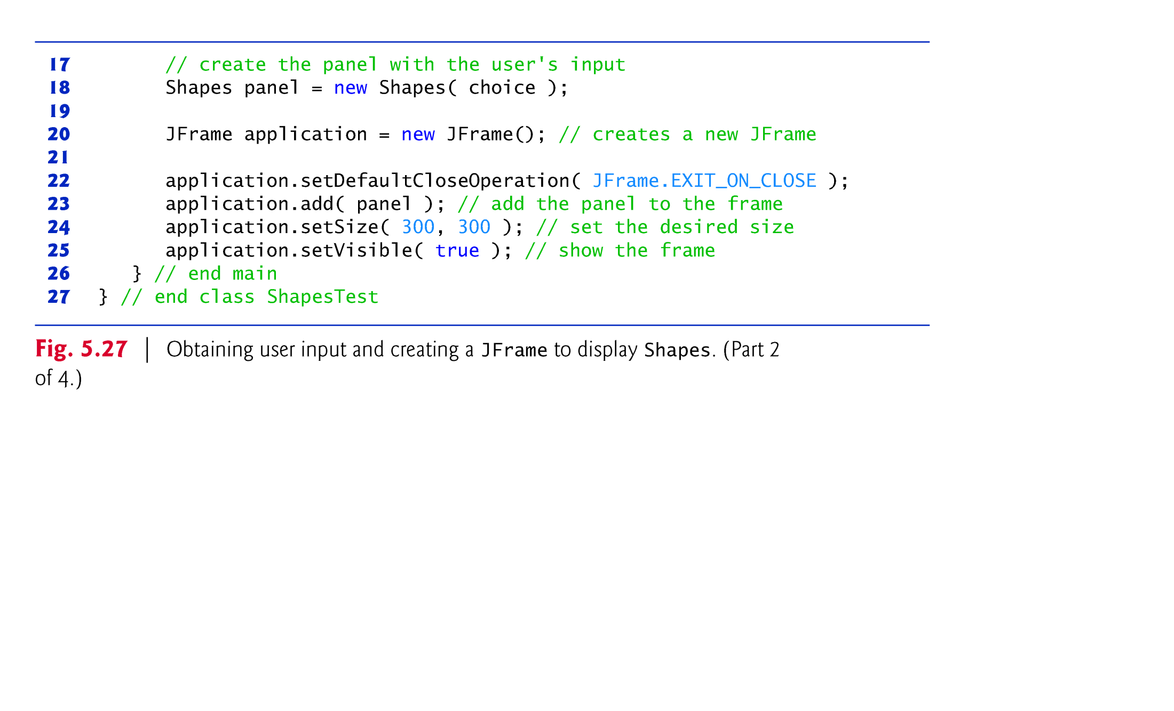

Slide 15
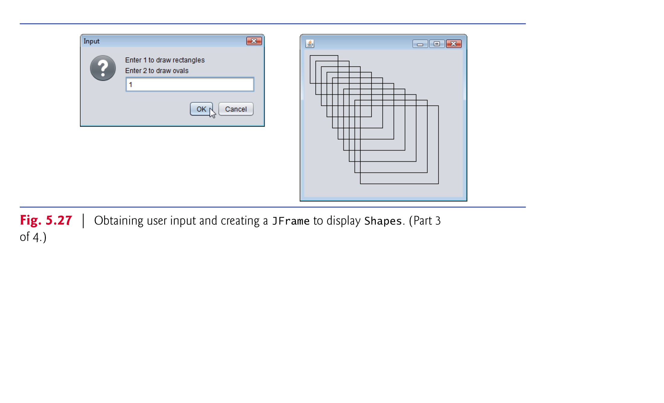

Slide 16
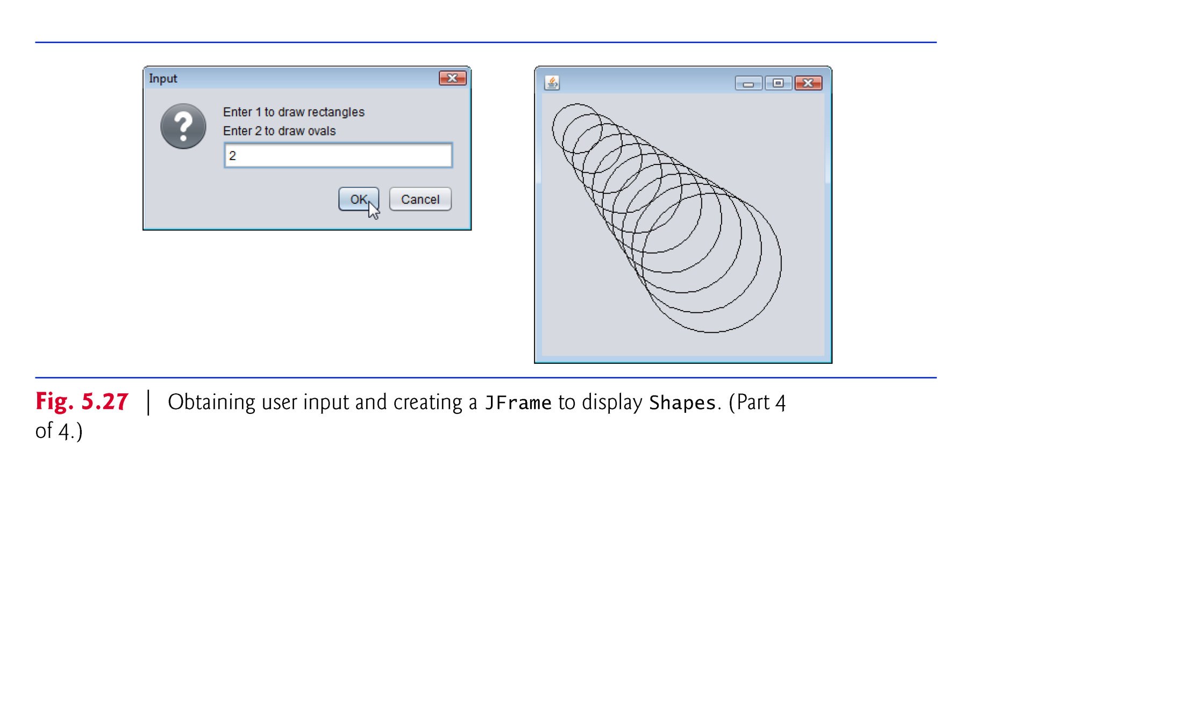

Slide 17
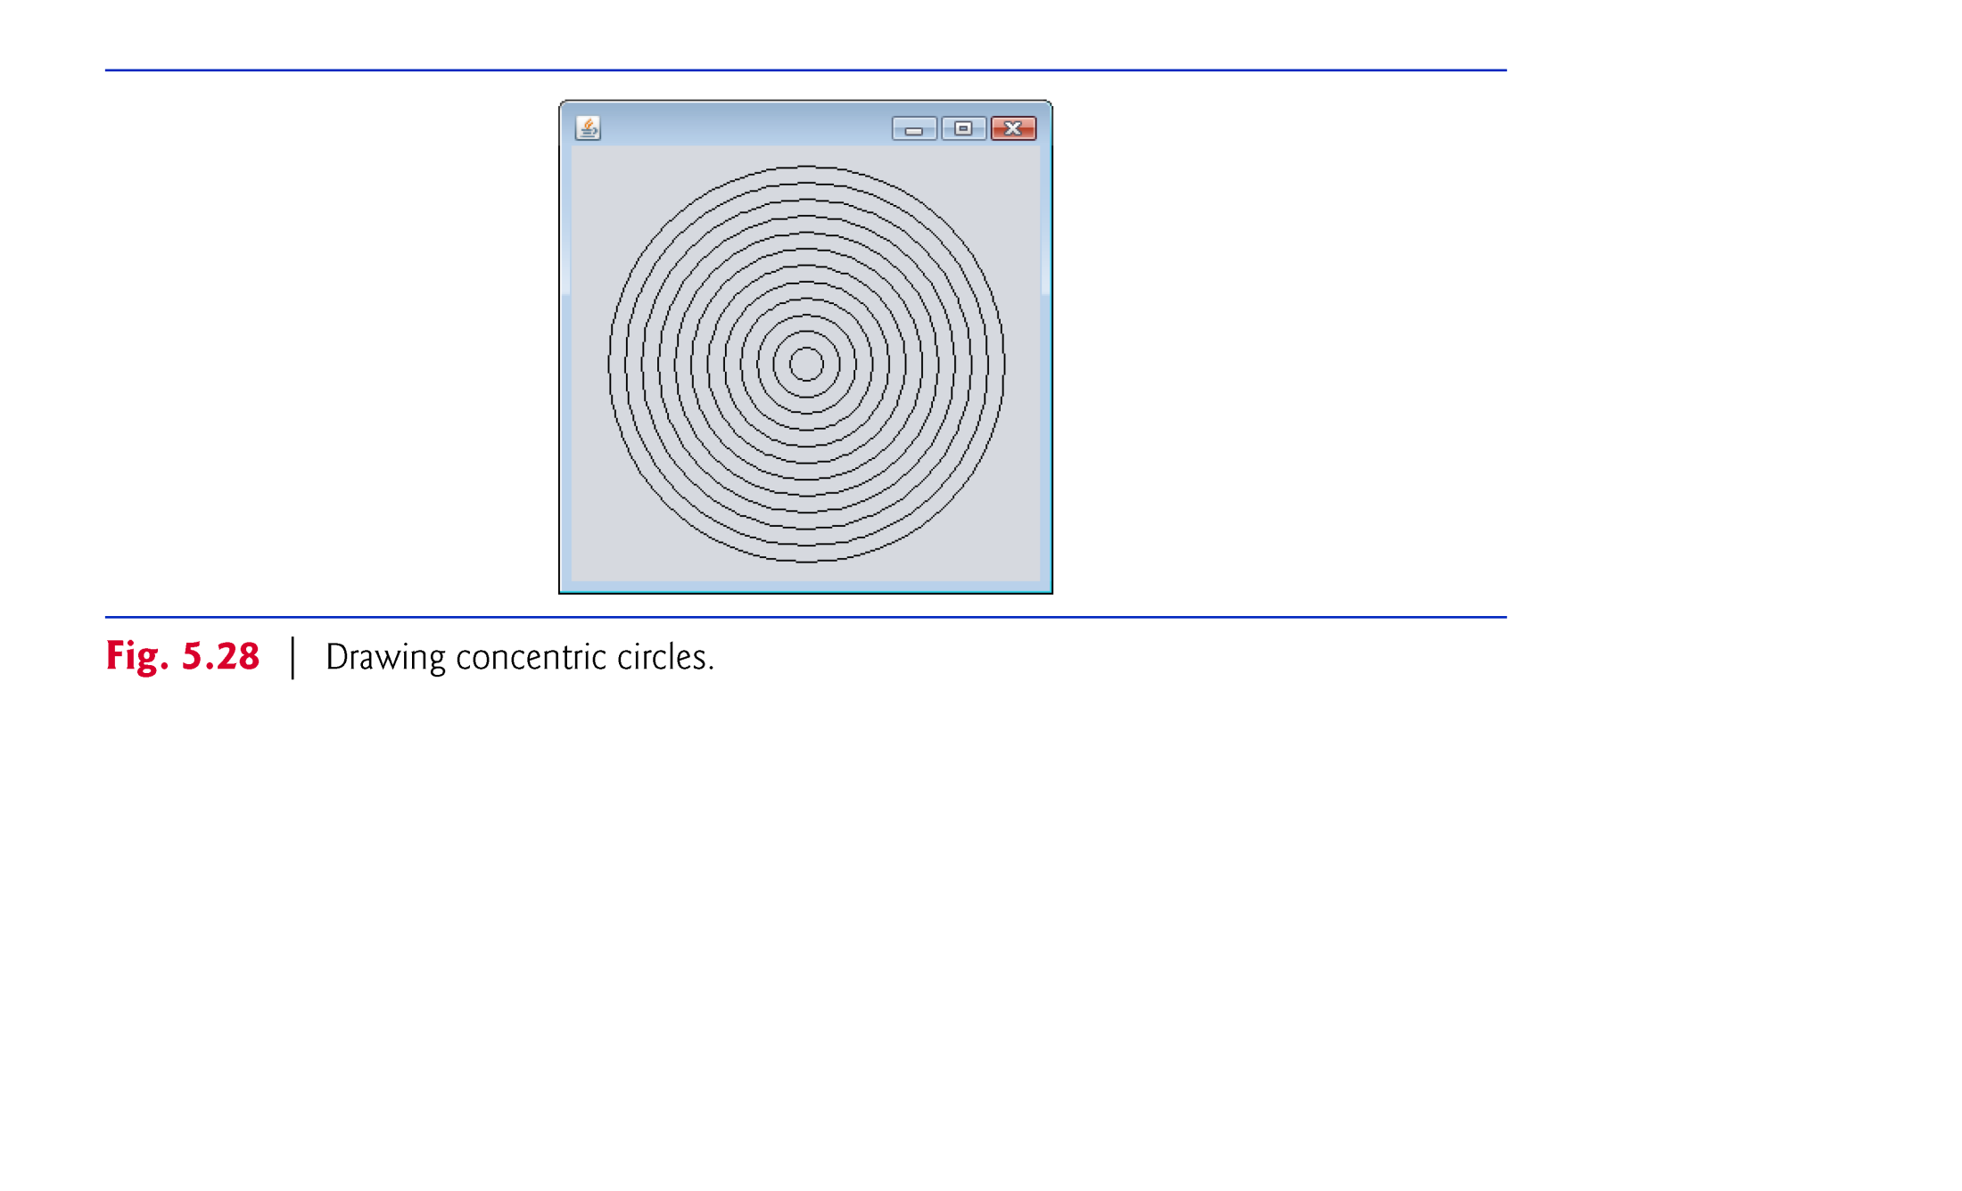

Slide 18
6.13 (Optional) GUI and Graphics Case Study: Colors and Filled Shapes (Cont.)
Class Color also contains a constructor of the form:
public Color( int r, int g, int b )
so you can create custom colors by specifying the red, green and blue component values.
Graphics methods fillRect and fillOval draw filled rectangles and ovals, respectively.
Graphics method setColor sets the current drawing color.

Slide 19
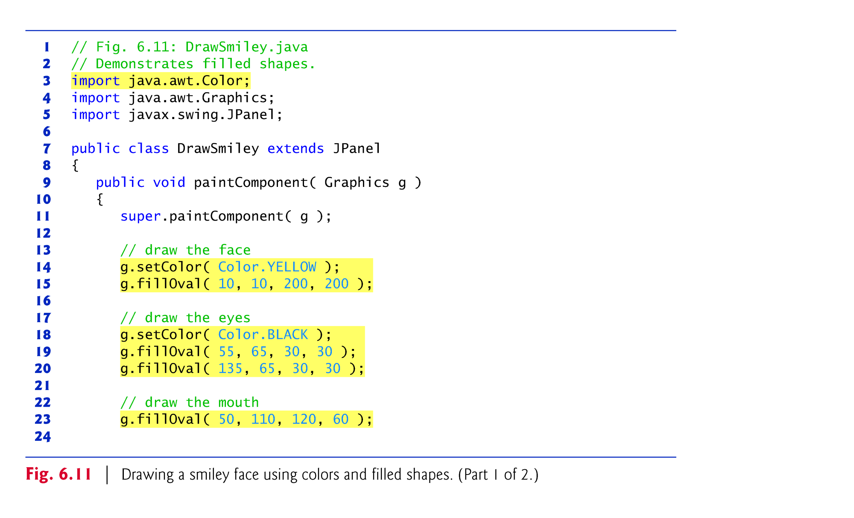

Slide 20
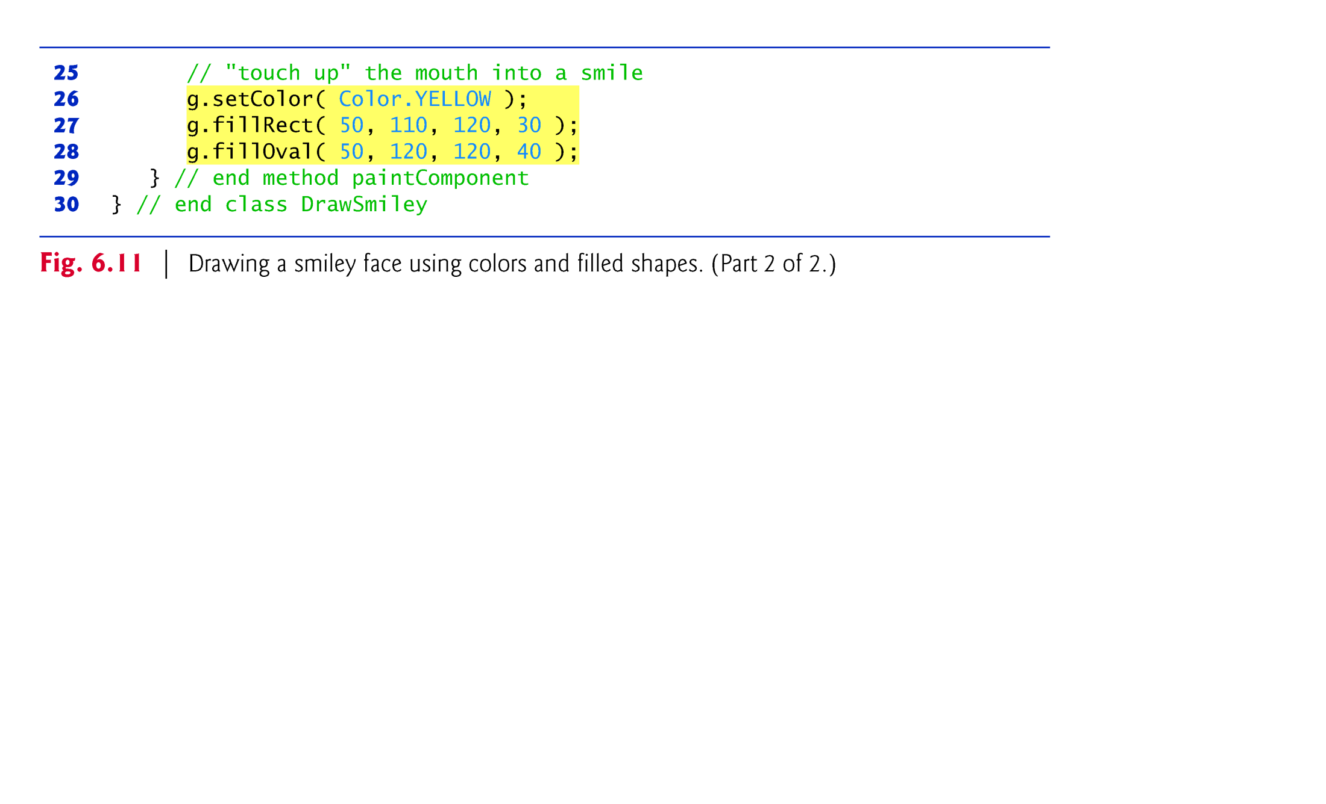

Slide 21
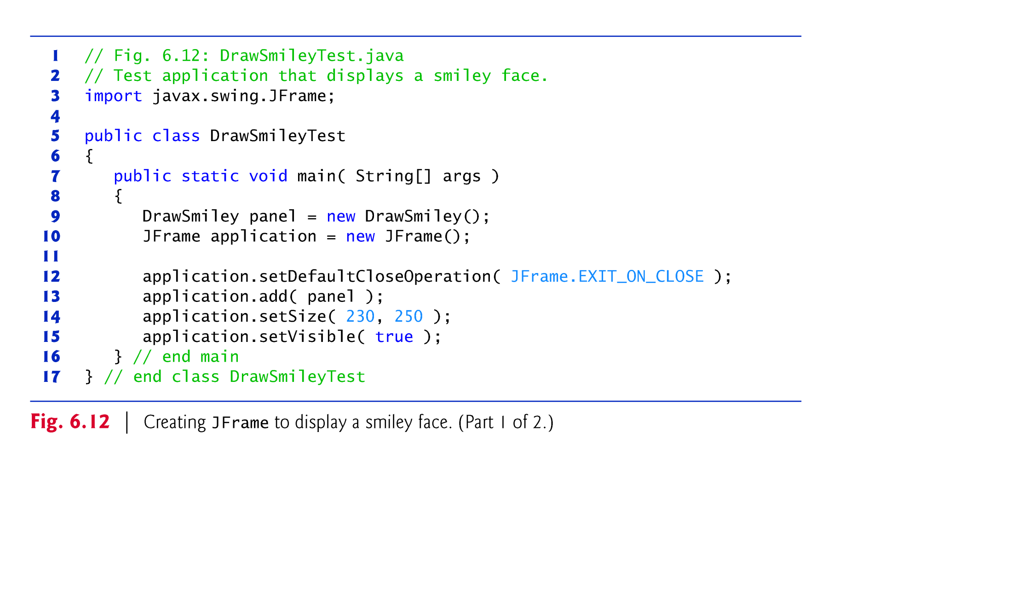

Slide 22
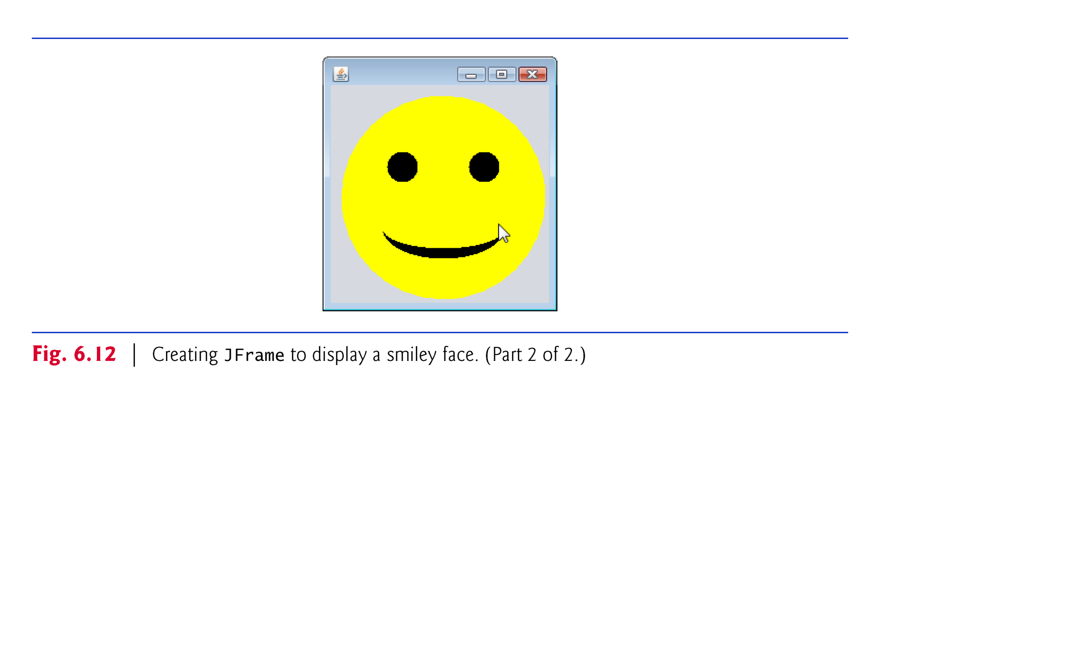

Slide 23
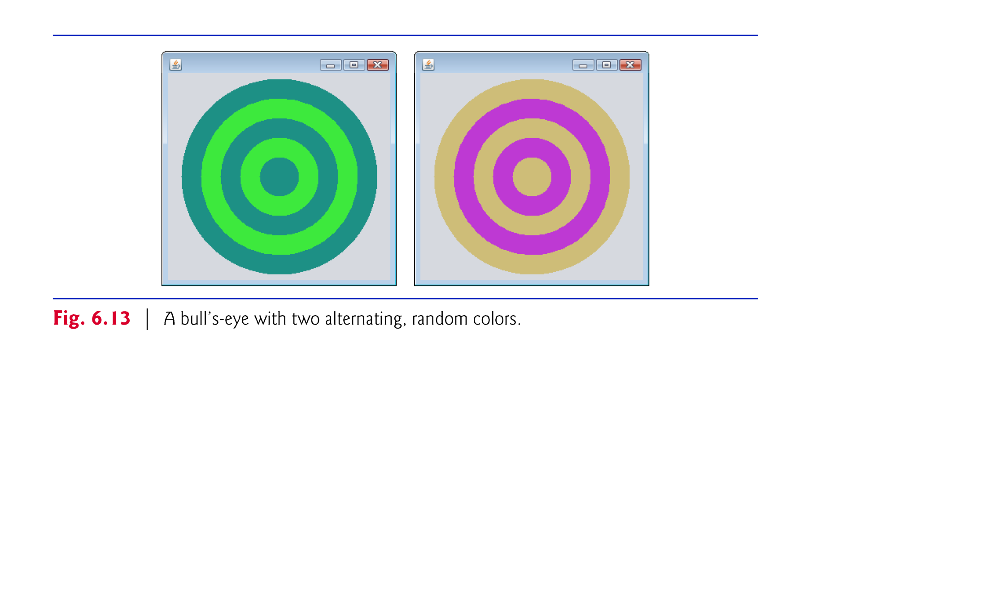

Slide 24
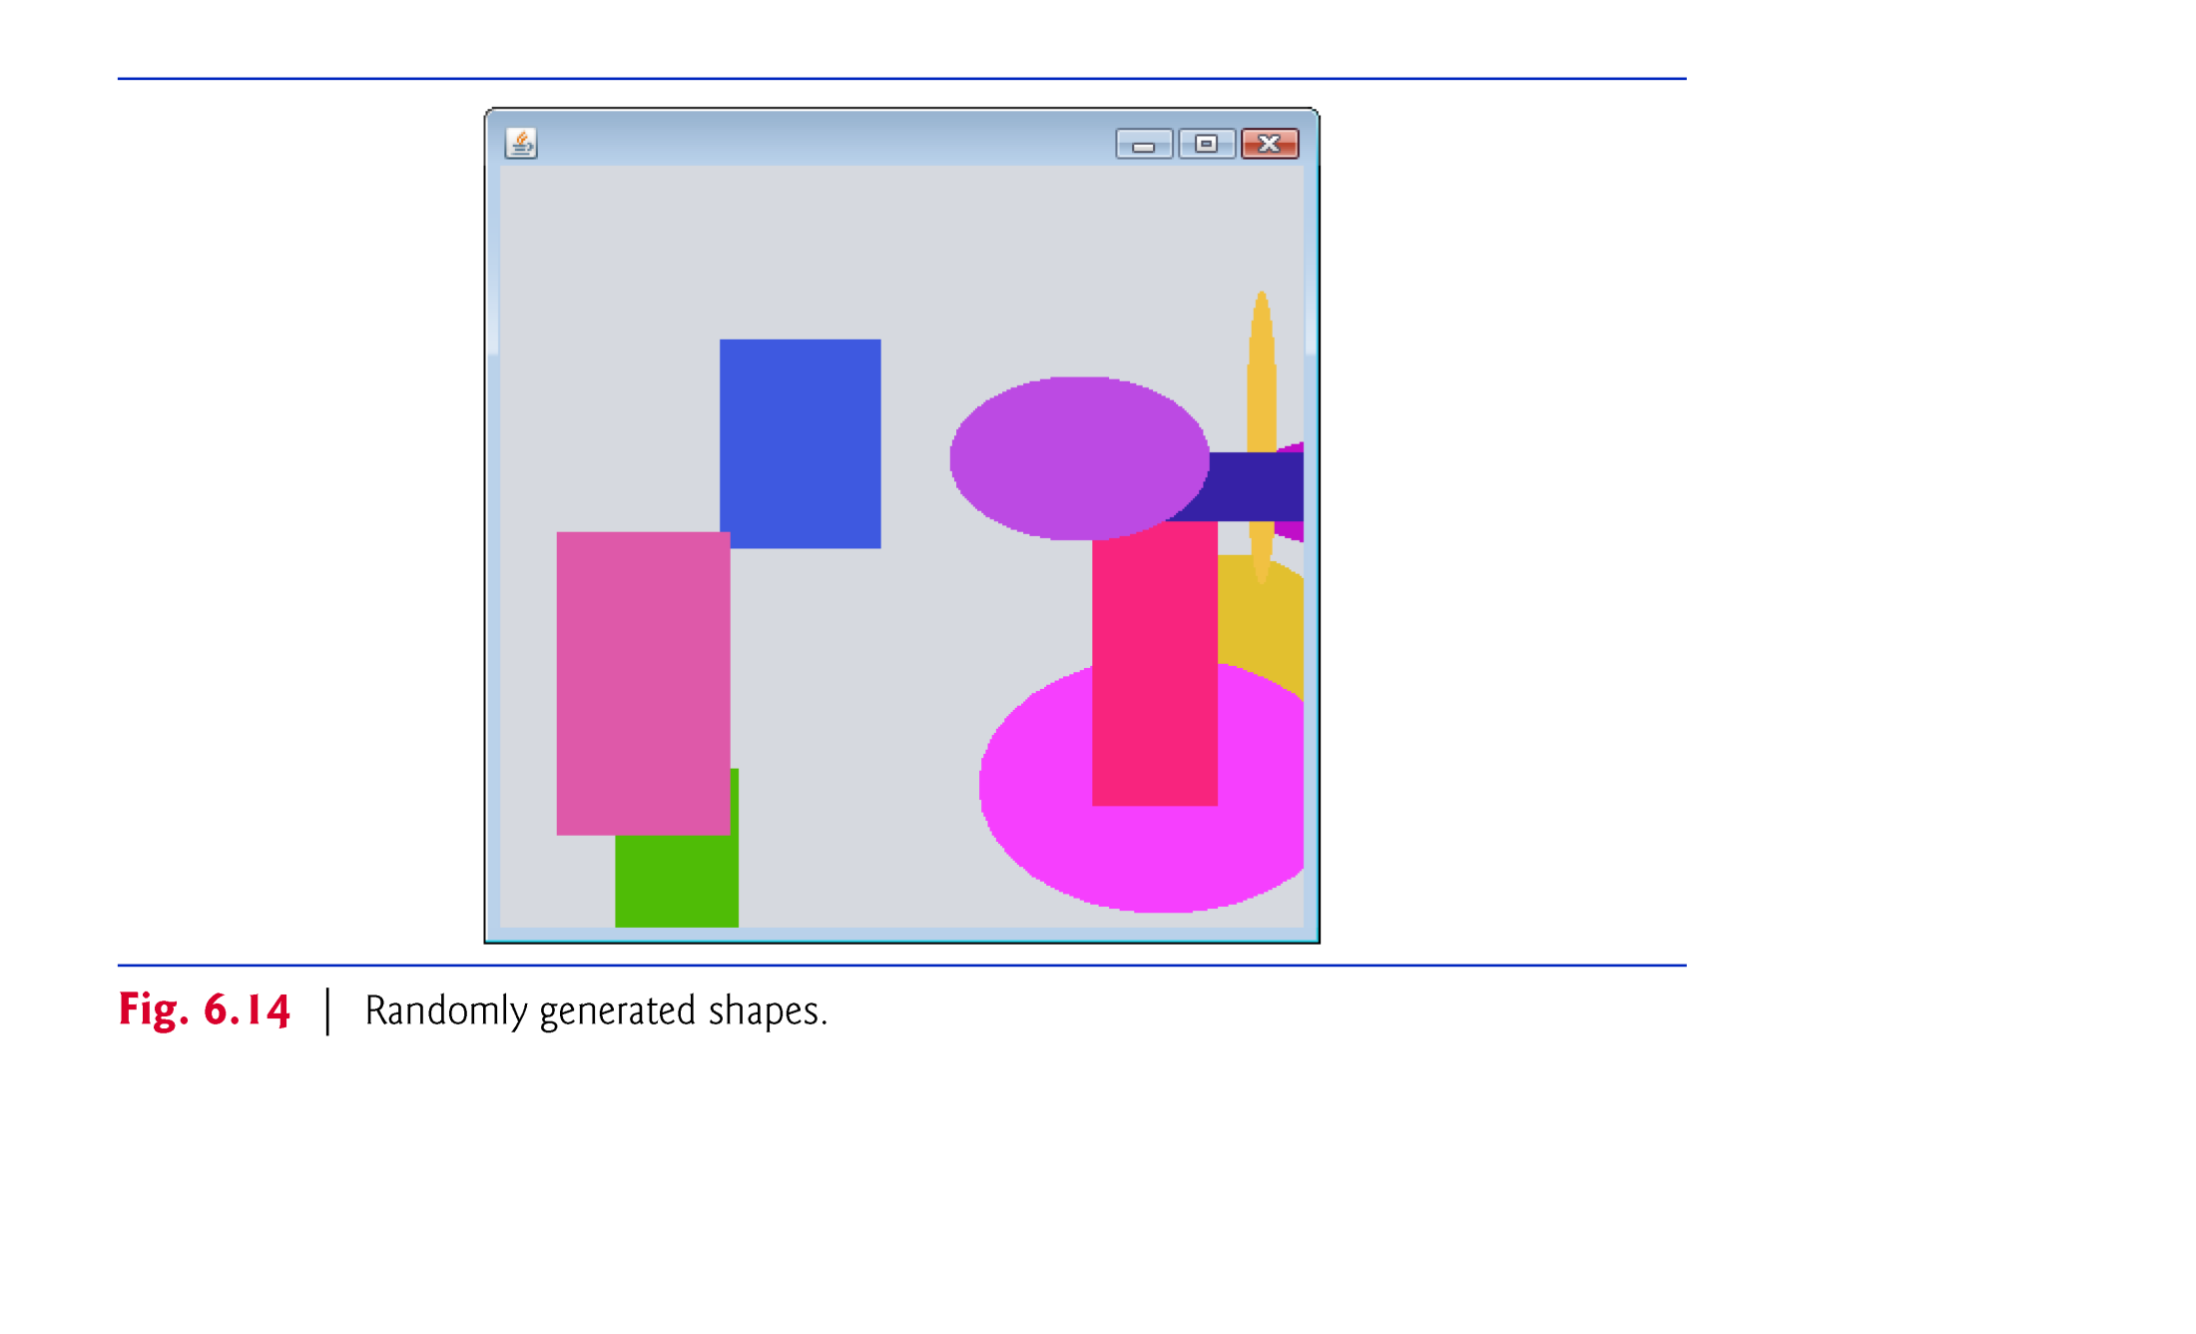

Slide 25
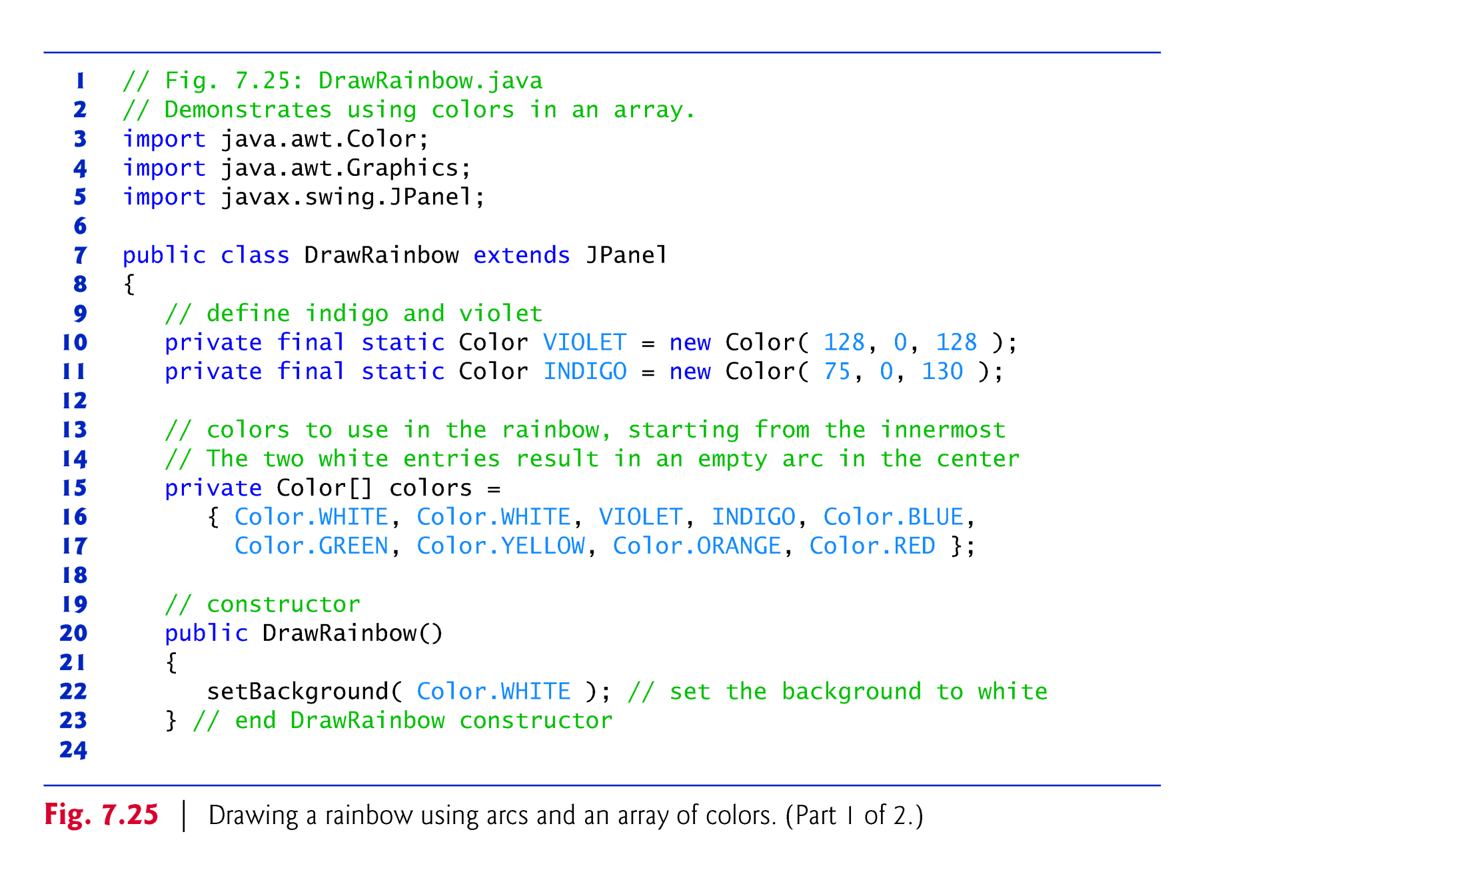

Slide 26
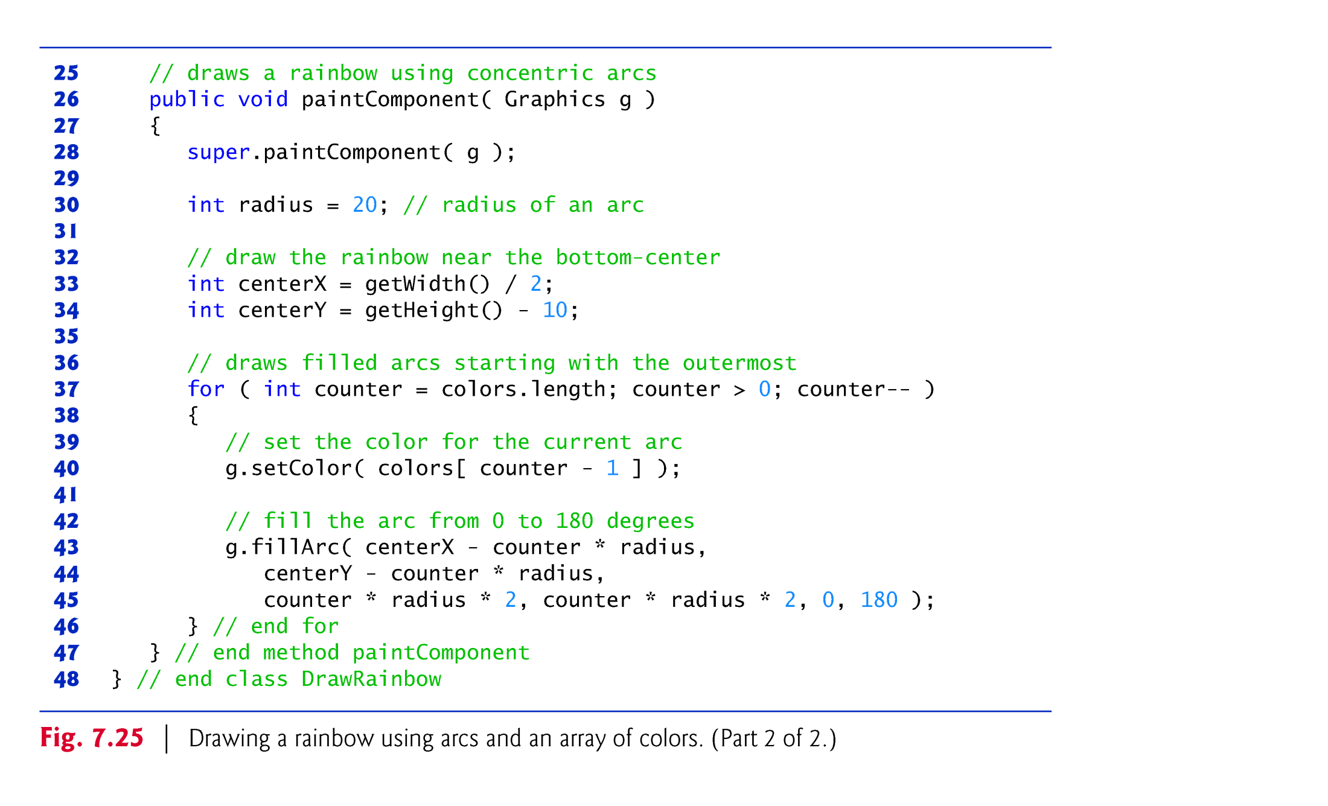

Slide 27
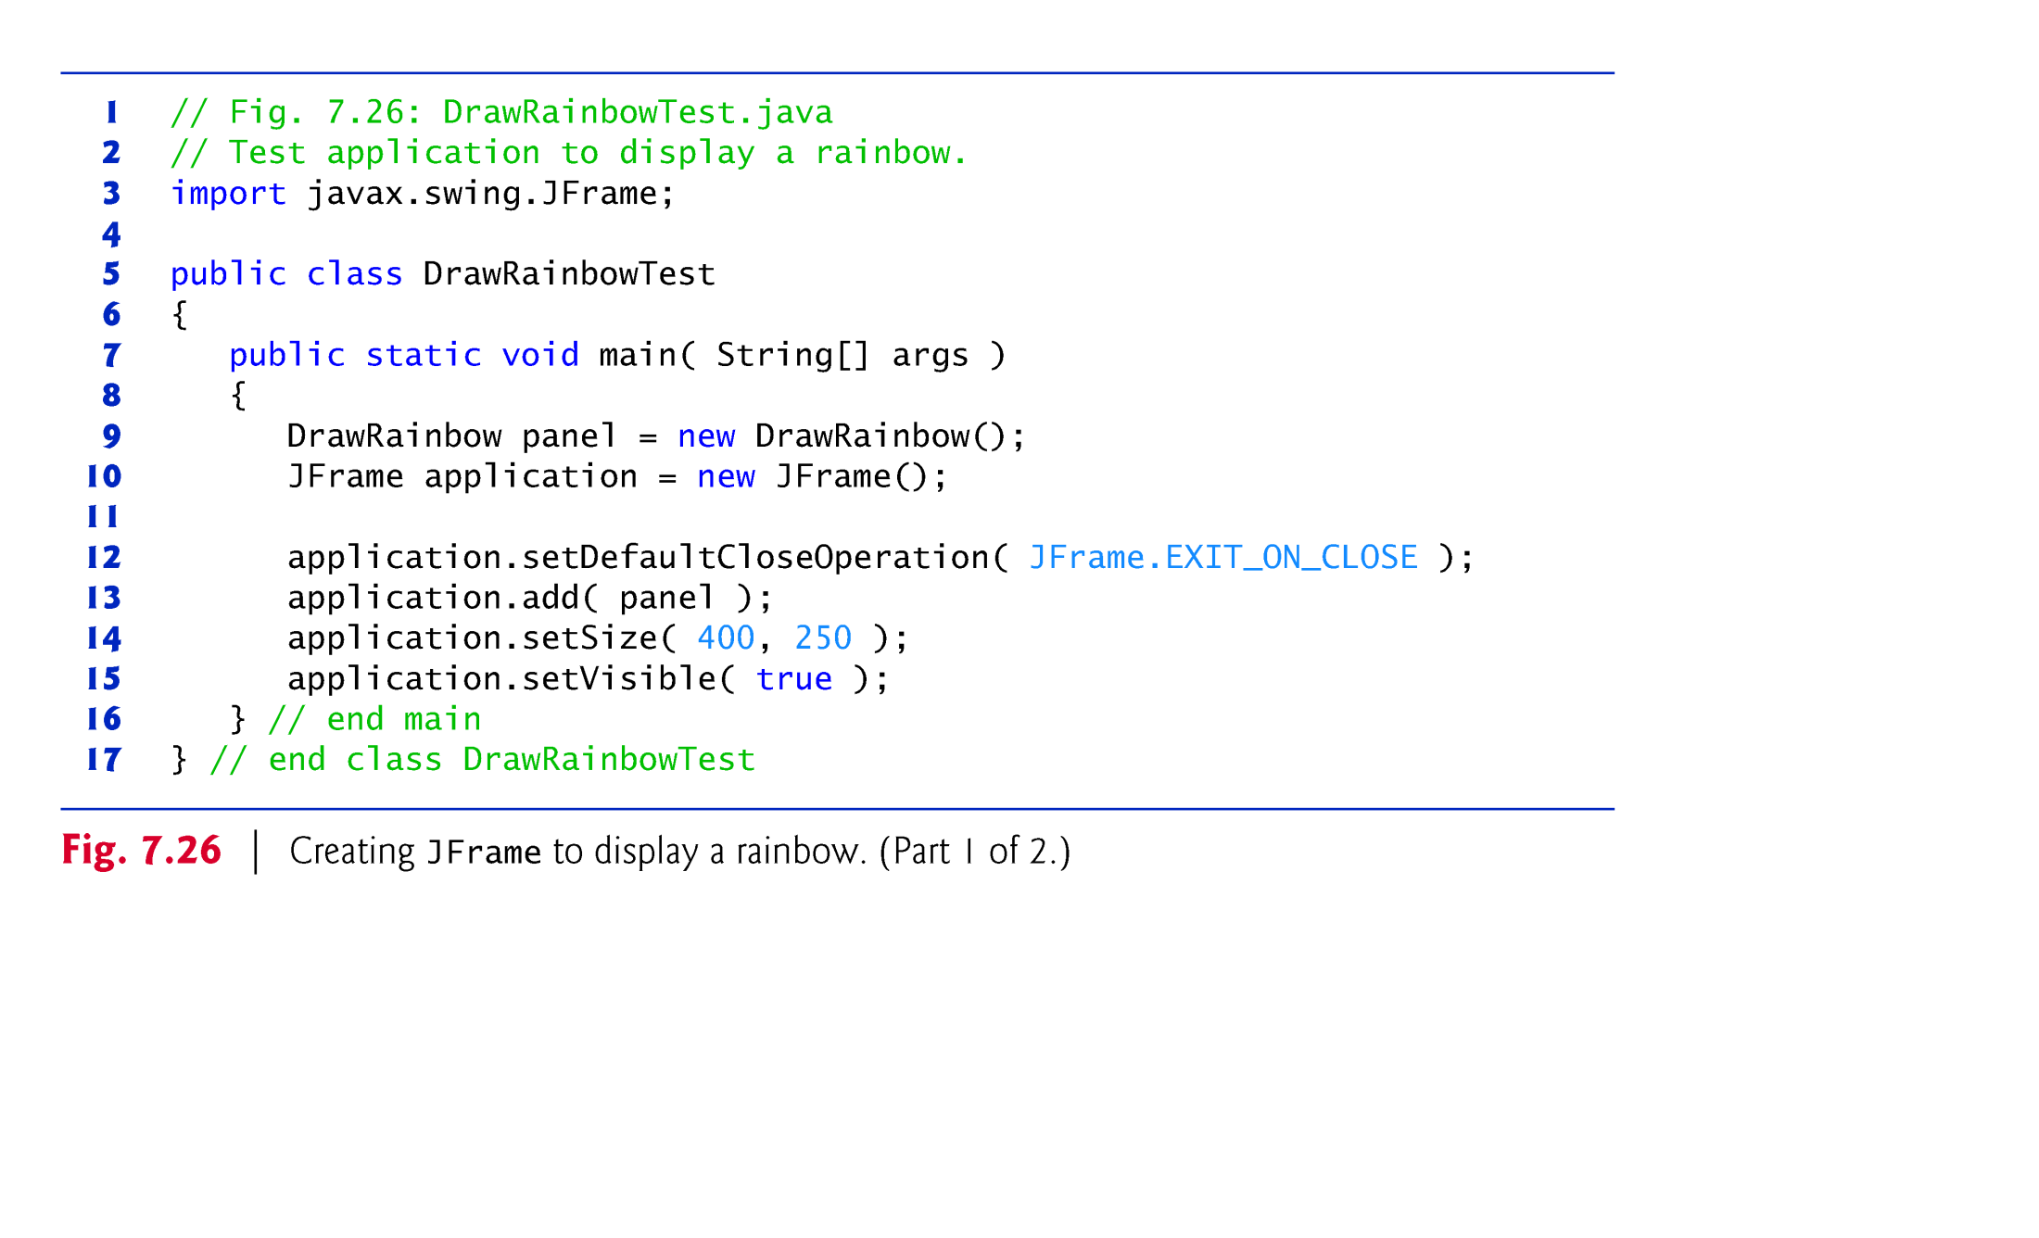

Slide 28
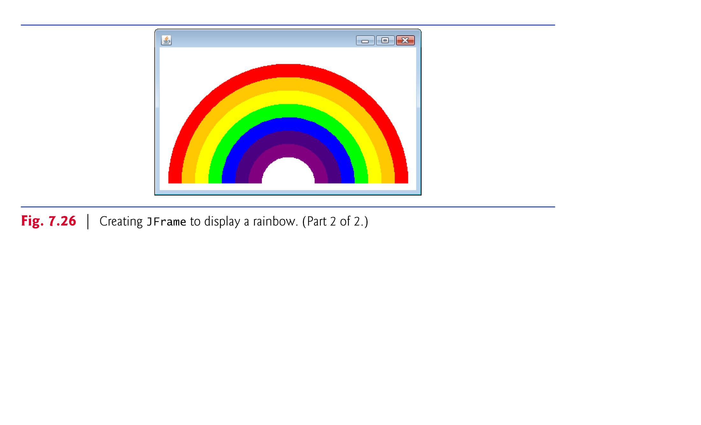

Slide 29
7.15 (Optional) GUI and Graphics Case Study: Drawing Arcs
Drawing arcs in Java is similar to drawing ovals—an arc is simply a section of an oval.
Graphics method fillArc draws a filled arc.
Method fillArc requires six parameters.
The first four represent the bounding rectangle in which the arc will be drawn.
The fifth parameter is the starting angle on the oval, and the sixth specifies the sweep, or the amount of arc to cover.
Starting angle and sweep are measured in degrees, with zero degrees pointing right.
A positive sweep draws the arc counterclockwise.
Method drawArc requires the same parameters as fillArc, but draws the edge of the arc rather than filling it.
Method setBackground changes the background color of a GUI component.

Slide 30
9.8 (Optional) GUI and Graphics Case Study: Displaying Text and Images Using Labels
Labels are a convenient way of identifying GUI components on the screen and keeping the user informed about the current state of the program.
A JLabel (from package javax.swing) can display text, an image or both.
The example in Fig. 9.13 demonstrates several JLabel features, including a plain text label, an image label and a label with both text and an image.

Slide 31
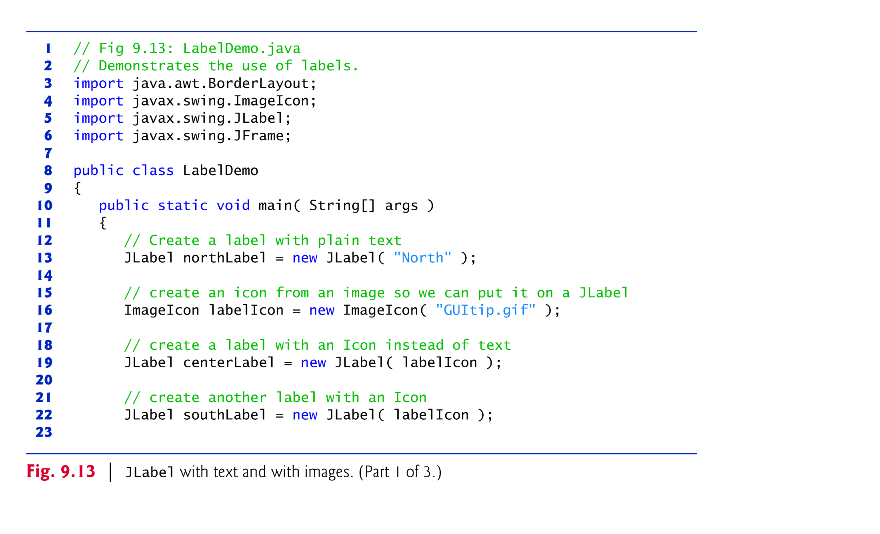

Slide 32
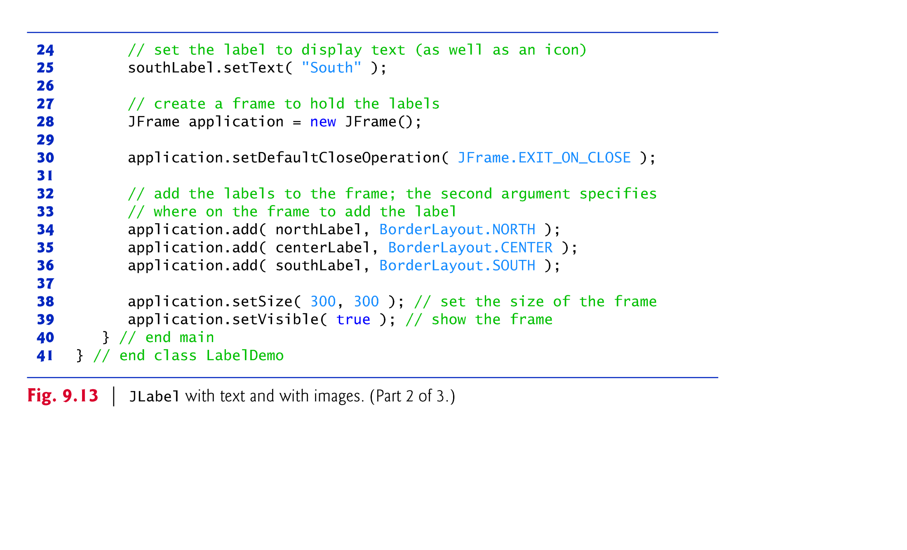

Slide 33
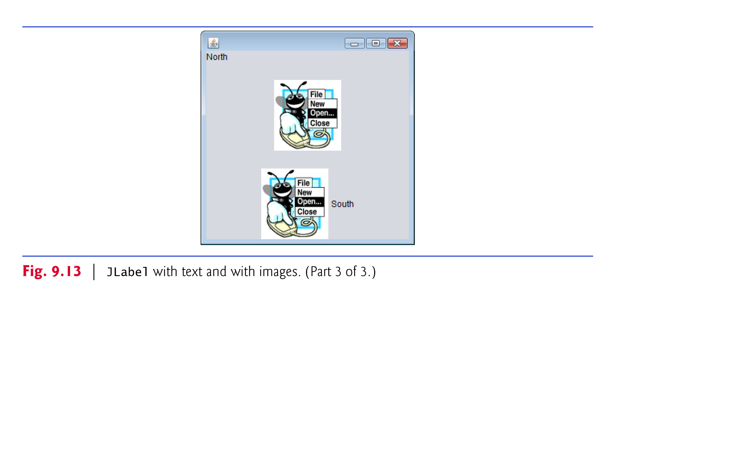

Slide 34
9.8 (Optional) GUI and Graphics Case Study: Displaying Text and Images Using Labels (Cont.)
An ImageIcon represents an image that can be displayed on a JLabel.
The constructor for ImageIcon receives a String that specifies the path to the image.
ImageIcon can load images in GIF, JPEG and PNG image formats.
JLabel method setText changes the text the label displays.

Slide 35
9.8 (Optional) GUI and Graphics Case Study: Displaying Text and Images Using Labels (Cont.)
An overloaded version of method add that takes two parameters allows you to specify the GUI component to add to a JFrame and the location in which to add it.
The first parameter is the component to attach.
The second is the region in which it should be placed.
Each JFrame has a layout to position GUI components.
Default layout for a JFrame is BorderLayout.
Five regions—NORTH (top), SOUTH (bottom), EAST (right side), WEST (left side) and CENTER (constants in class BorderLayout)
Each region is declared as a constant in class BorderLayout.
When calling method add with one argument, the JFrame places the component in the BorderLayout’s CENTER automatically.

Slide 36
